Slide 1
Cyclistic
The difference between Members and Casual users
Presented by: El Kharraz Saad
Last update on: 11/11/2021

Slide 2
Table of contents
Objective
Findings
Conclusions
Recommendations

Slide 3
Objective
The business task is to analyse how casual riders and annual members use Cyclistic bikes differently. A new marketing strategy that aims to convert casual riders into annual members will be designed from these insights.

Slide 4
Data Source
The source of the data is the company own website and it covers the previous 12 months (Sep 2020 - Sep 2021).
The data is public and it’s made available by Motivate International Inc. under this license.

Slide 5
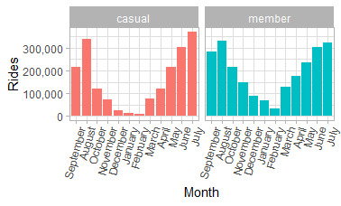
Number of trips sorted by: Month
In both cases there’s a spike during summer
In both cases there’s a drop during winter
A small percentage of members seems to use bikes all year long

Slide 6
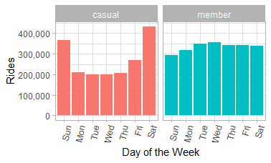
Number of trips sorted by: Day
Casual riders use bikes the more during weekends
Members use bikes regularly during the whole week
Consistent usage of bikes for casual riders during weekdays

Slide 7
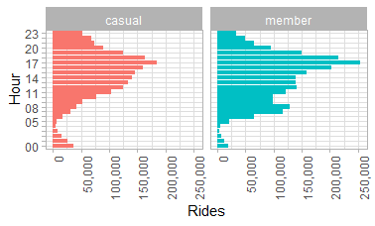
Number of trips sorted by: Hour
Members peak is during work hours (7am - 9am and 4pm - 6pm)
Casual riders peak is in the afternoon, between 3pm and 7pm

Slide 8
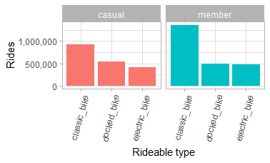
Ride type preference
Both casual and member users prefer to use classic bikes
In both cases electric bikes are the less used

Slide 9
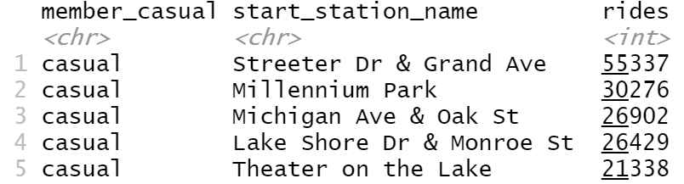
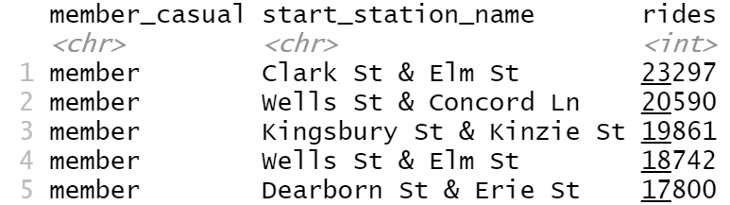
Popular stations
Casual riders most used station is: “Streeter Dr & Grand Ave”
Members most used station is : “Clark St & Elm St”

Slide 10
Conclusions
Classic bikes are the most popular ones between both casual users and annual members
Casual users usage is in the majority during the weekend. Although during weekdays they use bike consistently
Casual users have more than 55000 rides at the “Streeter Dr & Grand Ave” station and more than 33000 at the “Millenium Park” station
During the day the peak for members is exactly during the work hours, which most likely means that they use bikes to commute to work

Slide 11
Recommandations
The consistent use of bikes during the weekdays from casual users might mean that they are using them to commute to work. Those users should be strongly targeted
During the marketing campaign the area around the most used stations by casual users should have priority
The casual users that use the bikes during the fall and winter period are most likely not tourists, therefore potential new annual members
Creating a survey to clear up doubts about how the bikes are used and to gather personal data such as age and sex

Slide 12
Thank you
Feel free to ask any question

